Slide 1
GitHub Desktop
Opensource slution

Slide 2
I. About GitHub Desktop
GitHub Desktop is a part of GitHub.
A desktop application.
Full features of GitHub
Easy to use
Simple UI

Slide 3
II. How to use 1. Install
First, you must have a GitHub account. Register at https://github.com/
Download GitHub Desktop at https://desktop.github.com/
Run setup file

Slide 4
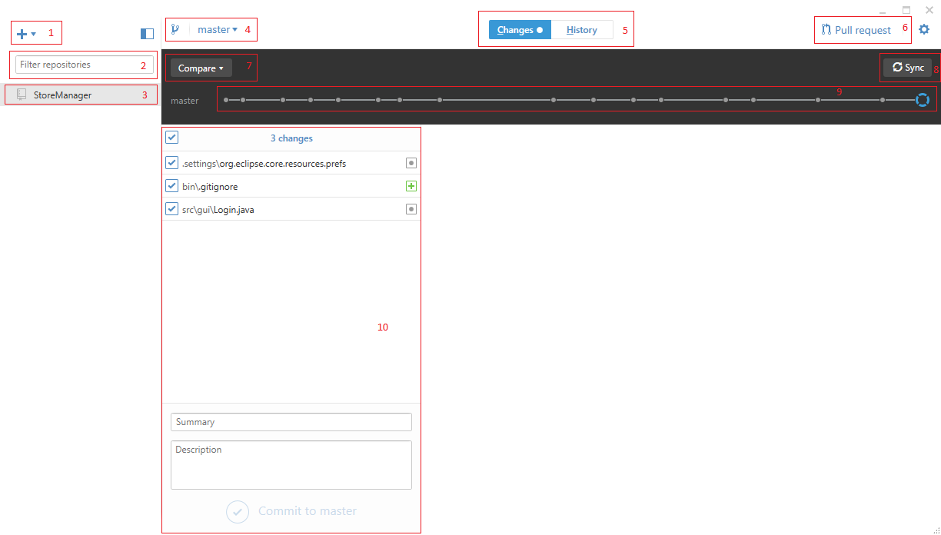
2. Overview

Slide 5
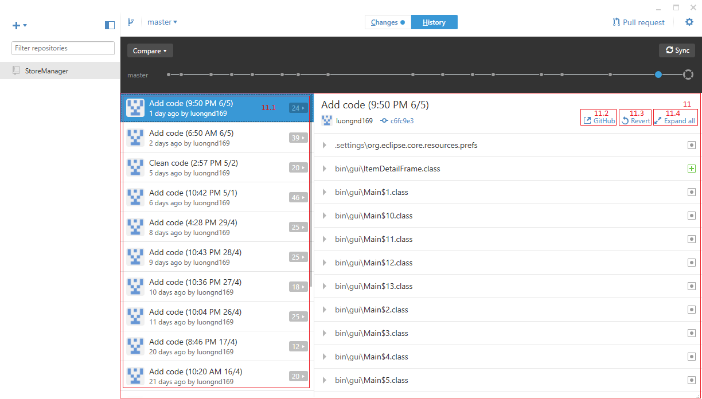

Slide 6
2.1. Explain
1- Add, create or clone new repository from your account to GitHub Desktop
2- Filter repositories there
3- Your repositories
4- Branch. You can create filter branch there
5- Changes and History tab of selected repository
6- Write and pull your request to any branch
7- Compare your changes with another branch
8- Sync your repository with GitHub repository
9- Change points
10- Your changes

Slide 7
11- History UI
11.1- Your committed
11.2- View selected commit in GitHub web
11.3- Create a new commit that reverts the changes in selected commit
11.4- Expand all file in selected commit

Slide 8

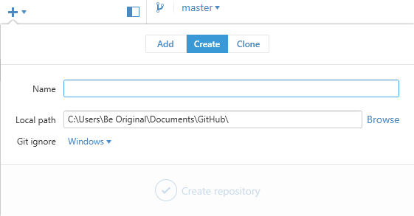
2.3. First use
Click and you will see
Now, you can add a local repository, create new GitHub repository or clone

Slide 9
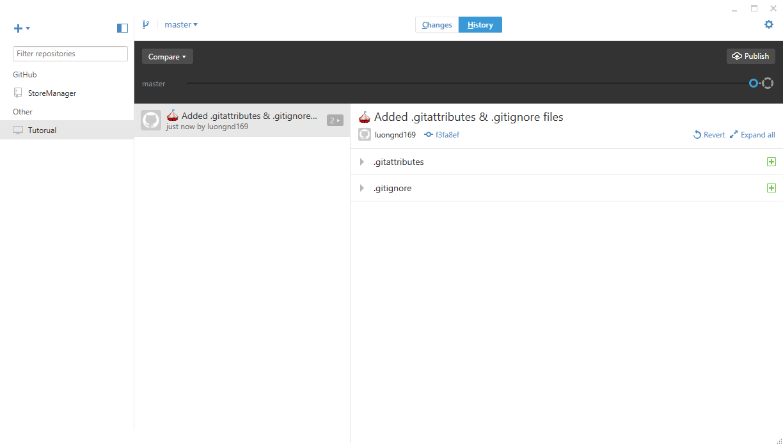
Tutorial repository was created
Now you can import this folder to your project
And publish that repository into GitHub

